Slide 1


WEEK 4
SPRINT 4
PL6
ENV

Slide 2


about us.

Slide 3
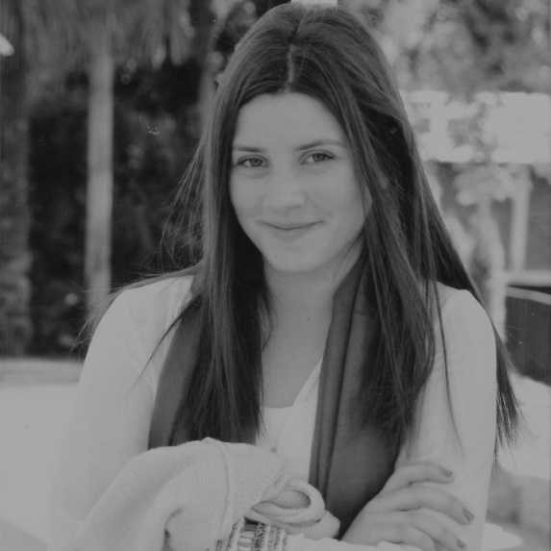
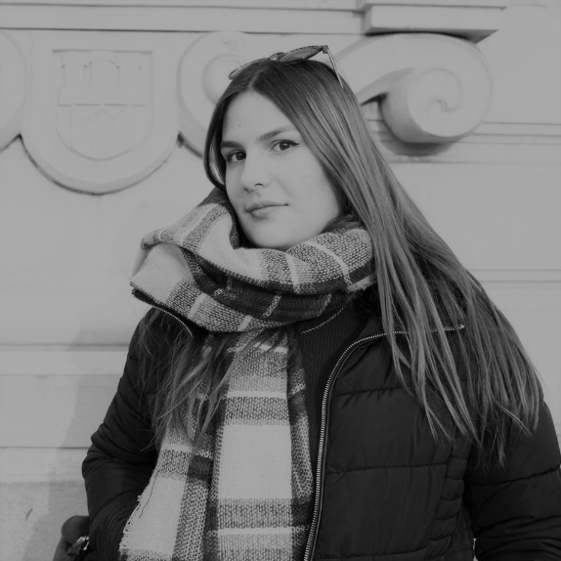
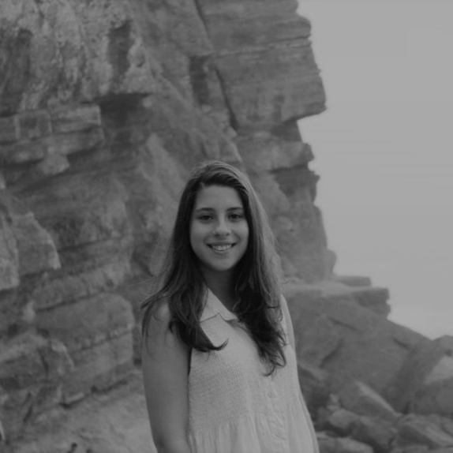
env.
Carla Mendes
Helena Tavares
Sara Costa

Slide 4
completed tasks.
 | TASK #1 | TASK #2 | TASK #3
TASK | Support to the other units | Managing Slack/GitHub/Trello | Weekly Presentation
OWNER | Unit | Helena Tavares | Sara Costa
GOAL EFFORT | 1h | 25min | 30min
EFFECTIVE EFFORT | 20min | 15min | 35min
STATUS | IN PROGRESS | IN PROGRESS | COMPLETED

Slide 5
completed tasks.
 | TASK #5 | TASK #6 | TASK #7
TASK | Updating the Architectural Software Document | Recolha e organização e apresentação dos dados recolhidos com o questionário | Actualização da secção de ENV do manual de Qualidade
OWNER | Carla Mendes | Carla Mendes | Helena Tavares
GOAL EFFORT | 40min | 45min | 1h
EFFECTIVE EFFORT | 56min | 1h17min | 1h 19min
STATUS | COMPLETED | COMPLETED | COMPLETED

Slide 6
planned tasks.
 | TASK #1 | TASK #2 | TASK #3
TASK | Managing Slack/GitHub | Supporting the other units | Weekly Presentation
OWNER | Helena Tavares | Helena Tavares | Sara Costa
GOAL EFFORT | 1h per week | 1h per week | 30min
STATUS | PLANNED | PLANNED | PLANNED

Slide 7
planned tasks.
 | TASK #4 | TASK #5 | TASK #6
TASK | Apresentação dos resultados e Redistribuir o formulário novamente | Continuar os artefactos | Análise dos formulários desta semana
OWNER | Carla Mendes | Helena Tavares | Sara Costa
GOAL EFFORT | 45min | 1h30 | 1h
STATUS | PLANNED | PLANNED | PLANNED

Slide 8
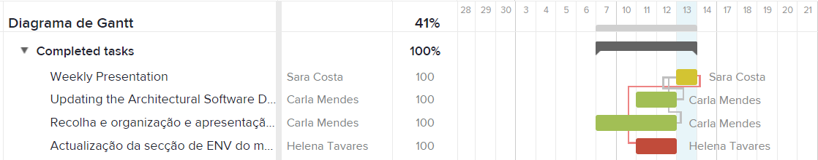
gantt diagram - effort.

Slide 9
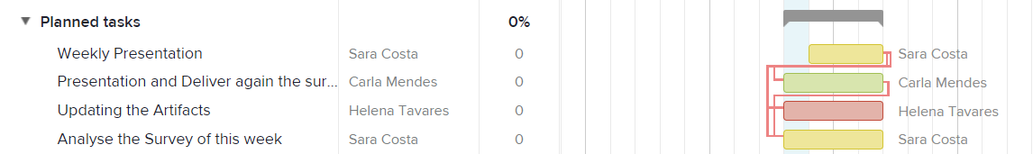
gantt diagram - planned.

Slide 10
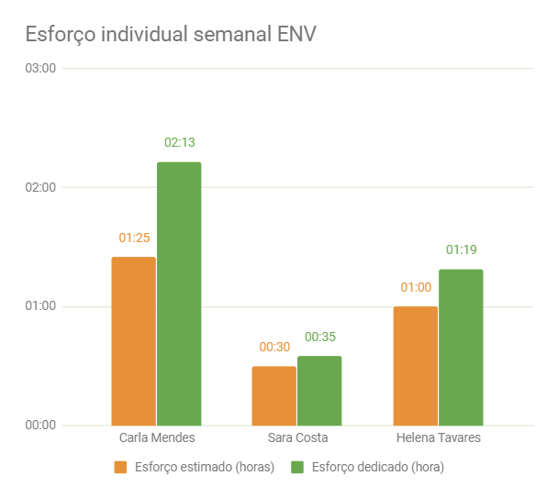
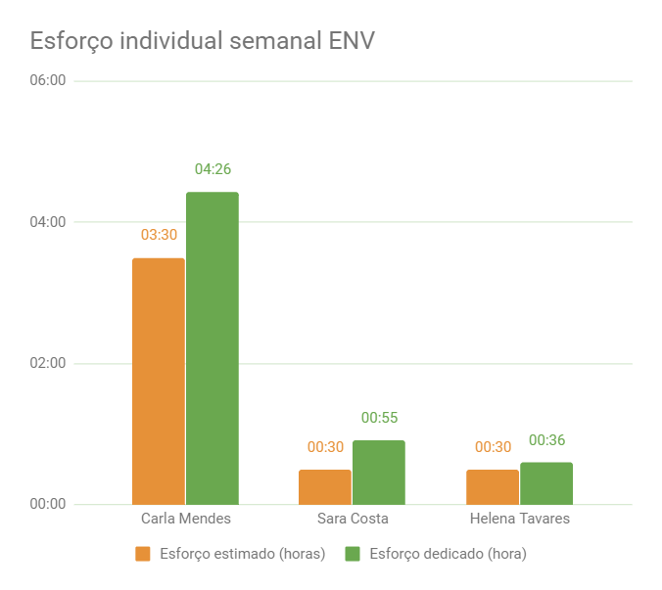
bar graph.

